Slide 1
Ticketstar: A MOVIE TICKET BOOKING WEBSITE
Megana Reddy Boddam
Sahana Pandurangi Raghavendra
May 25, 2022
8:00 pm - 8:20 pm

Slide 2
TABLE OF CONTENTS
01
02
03
SCENARIO
ARCHITECTURE
DATABASE
04
05
06
BUSINESS LOGIC
CLIENT INTERFACE
DEMO
Notes:
01 scenario – need to speak on what does our website do?

Slide 3
01
SCENARIO

Slide 4

Imagine you want to watch a movie …

Slide 5

But there is a long line for the tickets …

Slide 6

You get to the end of line …

Slide 7
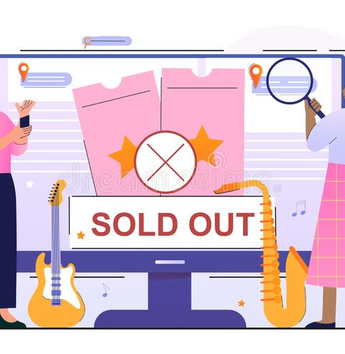
And the show is sold out for the day …

Slide 8

maybe you decide to see another movie …

Slide 9
But there is a long line for the food …

Slide 10

And the theater is out of popcorn …

Slide 11
CUSTOMER VALUE
Book tickets in advance, no need to wait in line, guaranteed spot in theater for show, guaranteed food at pickup

Slide 12
02
ARCHITECTURE

Slide 13
System Design Considerations
The following considerations were made while designing the system:
We assume that the clients of our services do not require authentication through their email account username and password. All the authorized users inherently have an API key generated by the Amazon API gateway, and they access the services through this key and the gateway.
The clients of the system are assumed to book at least one movie ticket; so, all the three services in the system are sequentially traversed.
The system is implemented from the perspective of user role only.

Slide 14
TECHNOLOGY STACK
Database
MiddleTier
FrontEnd
REST APIs
REST APIs
Oracle MySQL
Amazon RDS
Node.js
Amazon Lambda Functions
HTML, CSS, Node.js
Amazon API Gateway, Postman, API keys, Visual Studio Code
Technology
Platform

Slide 15
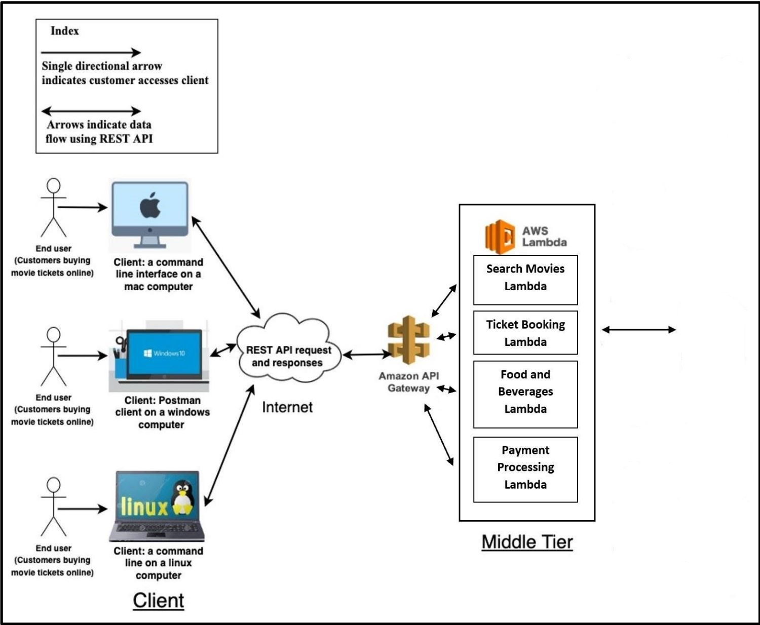



Client: Web Browser on a MAC Computer
Client: Web Browser on a windows computer
Client: Web Browser on a Linux Computer

Slide 16
03
DATABASE
Database is built using Oracle MySQL
It has total of 11 tables that help in storing users, theater, movies , seats and booking information.
The AWS RDS database is used.
Lambda functions executes queries on to the database.

Slide 17
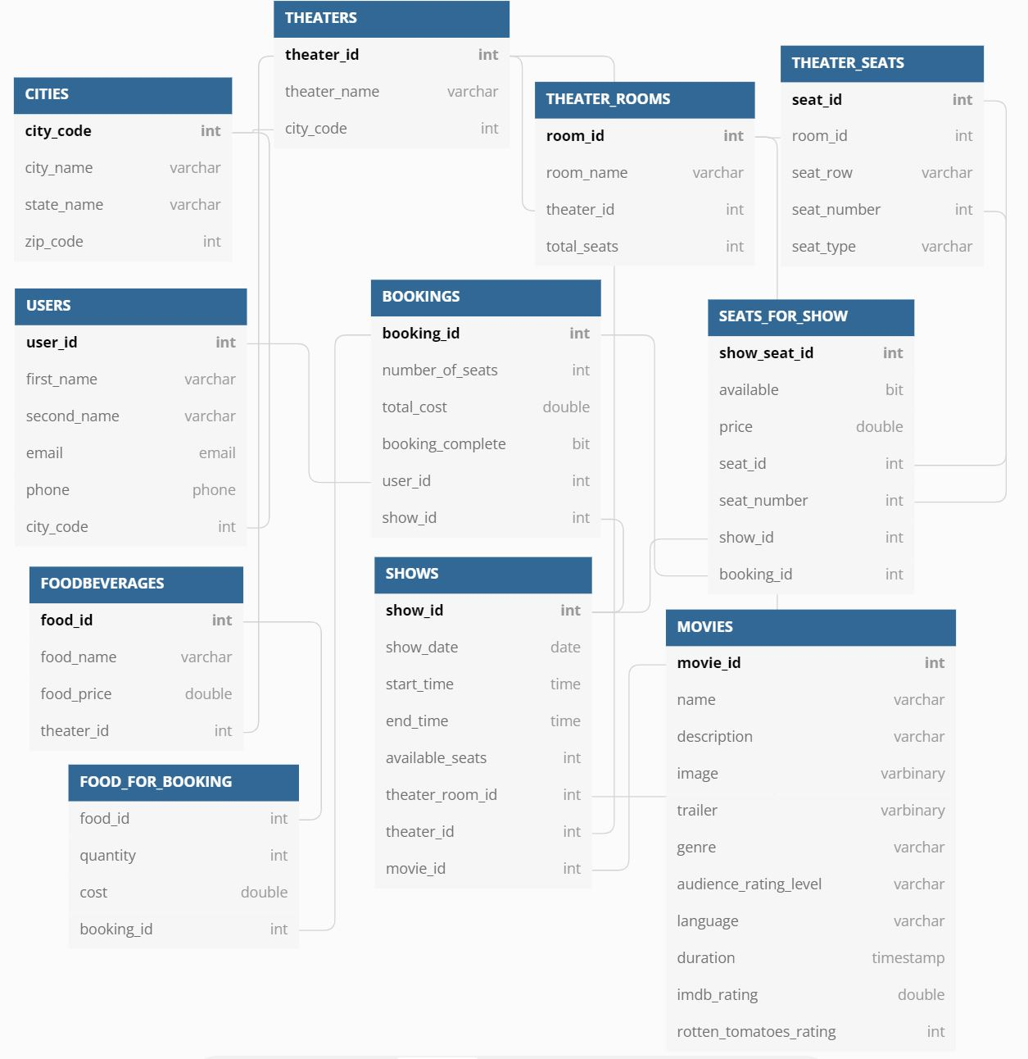
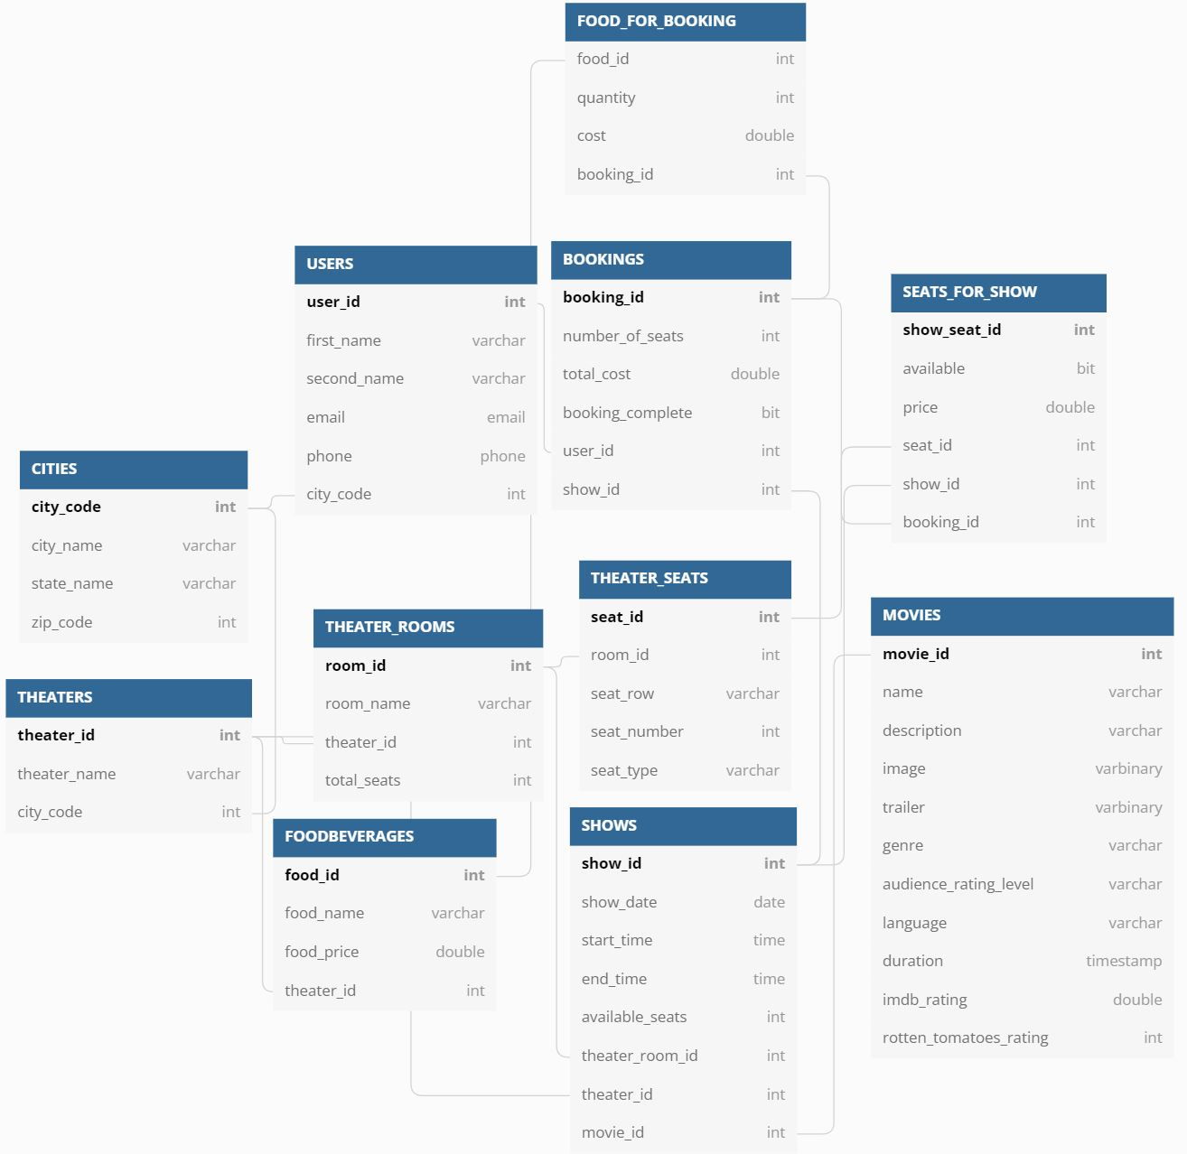

Slide 18
04
BUSINESS LOGIC
We have implemented our middle tier using the AWS infrastructure to make our system reliable, highly available and horizontally scalable.
HTTP REST APIs, communicate with the client-tier using the Amazon API gateway, and communicate with the back-end databases using API endpoints and AWS lambda.

Slide 19
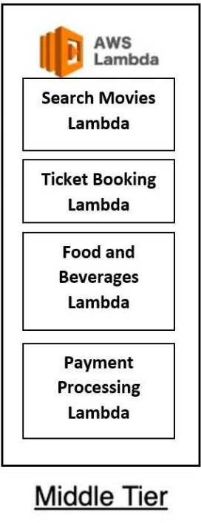
getuser
addnewuser
listofcities
listoftheaters
listofmovies
Interfaces Implemented: REST APIs
listofshowdates
listofshows
listofshowseats
addshowseats
listoffood
bookingcost
listoftickets
Notes:
Search Movies
'/listofcities'
'/addnewuser'
'/listoftheaters';
'/listofmovies';
'/getuser’;
Ticket Booking
'/listofshowdates';
'/listofshows';
'/listofshowseats';
'/addshowseats’
Food Ordering
Listoffood
Payment Processing
Bookinngcost
listoftickets

Slide 20
Functionalities of the Lambda function
Search Movies Lambda: Adds the users to the database and helps them search movies based on theaters and cities..
Ticket Booking Lambda: Displays the available shows based on time and date and helps the user book seats in a selected theater.
Food and Beverages Lambda: Helps the user pre-order food before the movie starts
Payment Processing Lambda: Displays the total cost of tickets and food to the user and displays ticket information containing the seat number, show time, theater name, city and the total cost of the ticket.

Slide 21
05
CLIENT INTERFACE
The front end client built using HTML and CSS send HTTP requests to the API gateway.
The API gateway routes the appropriate requests to the Lambda functions
The Client interface used API key to access the APIs hosted on AWS.
The front is also hosted on AWS and can be accessed using the URL: https://9qhi5gewy6.execute-api.us-east-1.amazonaws.com/prod/pages/home

Slide 22
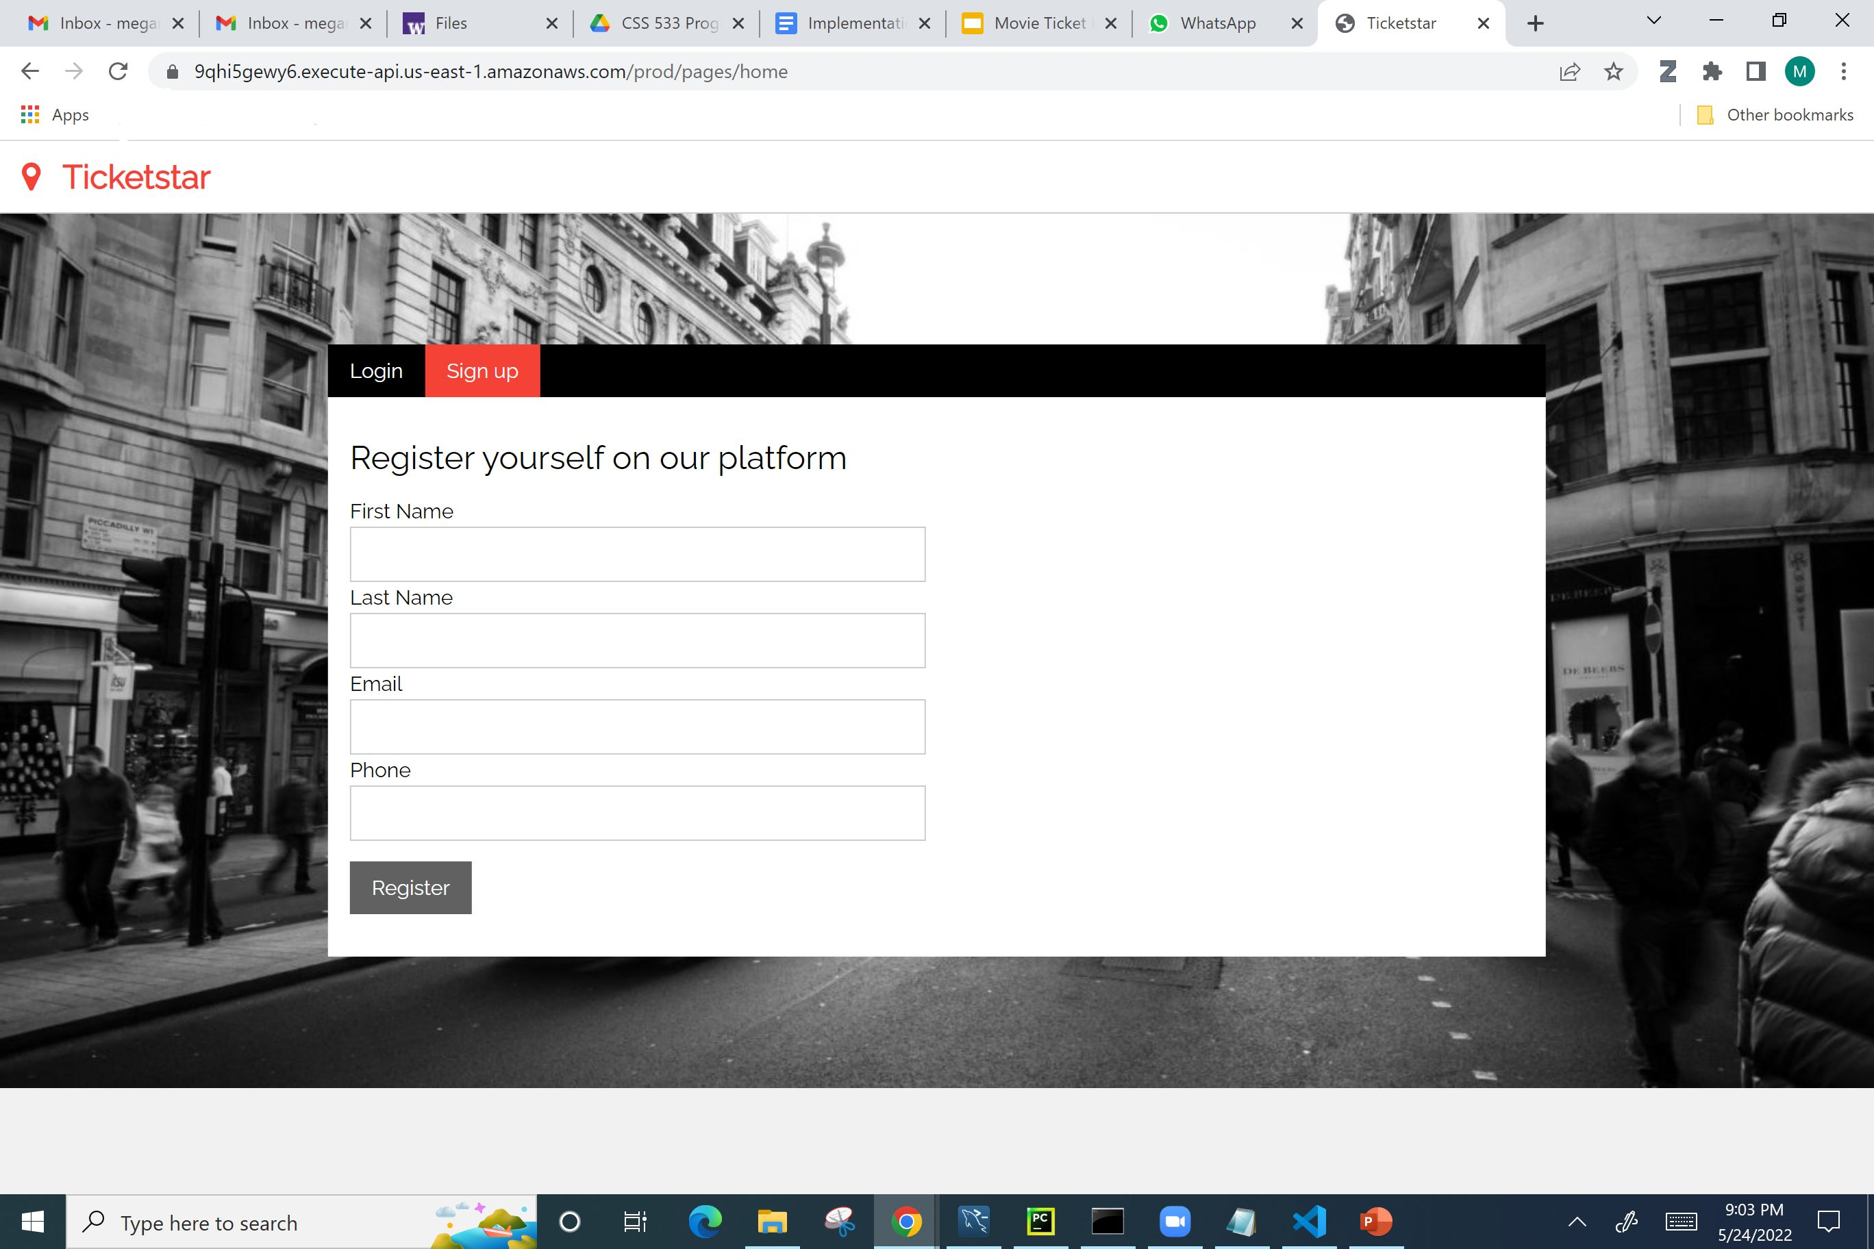

Slide 23
06
DEMO

Slide 24
REFLECTIONS
Challenges
Successes / Enjoyable Aspects
Add/Cuts and Future Directions
Familiarize ourselves with technologies
Difficulty in coming up with the correct design and implementation details
Needed to perform a lot of trial and error
Underestimated the scope of project and efforts needed to complete it
Delivered a working ticket booking system with planned functionalities
Went above and beyond planned CLI and built a Front-End
Learnt new technologies and gained confidence in Distributed Computing.
Yes we were able to implement everything in our initial proposal except implementing the Cache and a replication database
We added a UI that we had not planned.
Future direction is to create an administrative user with features to modify the database and make the product more scalable with more users and theaters

Slide 25
Thank You!

